Slide 1
IoT Smart-Lights
Sr. Design 21-20
Hamza Mostafa Sayed Mahmoud habdul@iastate.edu
Nathan Orts njorts@iastate.edu
Xinlei Yu xinleiyu@iastate.edu
William Gavins wpgavins@iastate.edu

Slide 2
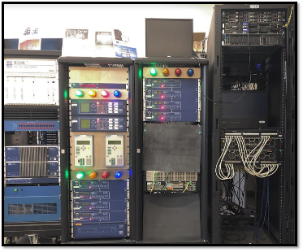
What is the problem?
In power grid simulations in the PowerCyber Lab:
Relays’ status are shown by 12 seperate lights mounted on the hardware running the simulations.
Current system is incapable of representing large scaled simulations.
Outreach demonstrations were done through a livestream of the lights via a video camera in the lab.
Hard to view the status of the relays when the status lights are fixed to the hardware.
Hard for viewers to visualize the simulated power grid.
Current system is physically unmovable.
Very Limited audience, preventing exposure.
Notes:
Hamza

Slide 3
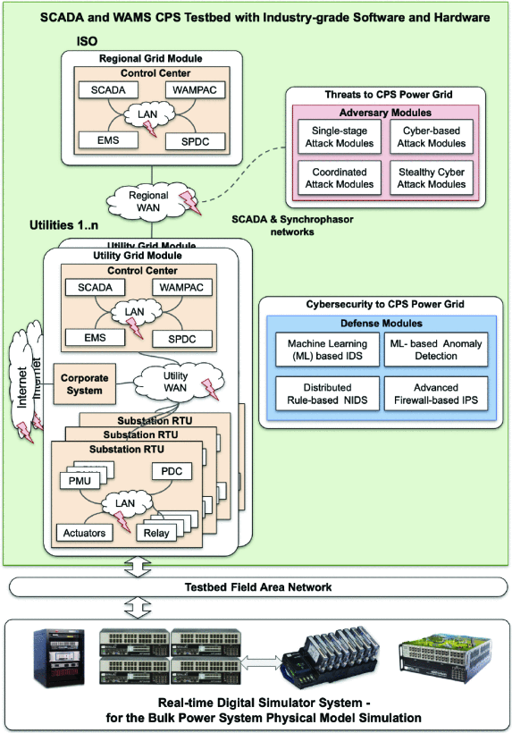
PowerCyber Lab Background
The PowerCyber Lab has several types of systems used to simulate usage of large scale power grids, when combined with ISEAGE the Lab is able to simulate security of these systems.
The PowerCyber Lab has several control centers which are composed of IEDs(intelligent electronic devices) and PLCs(programmable logic controllers) of which are potential surfaces for cyberattacks. The goal is to use the smart technology to represent the current states of these components of the simulation and allow interaction with the simulation through hardware buttons.
Source: https://ieeexplore.ieee.org/document/9241284

Slide 4
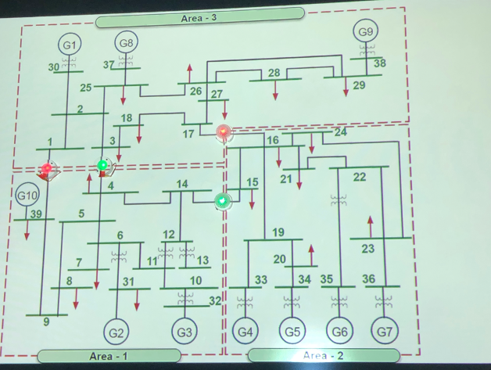
Proposed Solution
Moving forward, IOT is a clear solution.
Users can Project the cyberPower power grid map to represent the simulation on a whiteboard.
Each Smart Light represents a location that is simulated on the PowerCyber Lab simulation.
Users can deploy IoT Smart lights to represent states on the projected powergrid.
Using magnets to adhere to the board.
Better visualization for the running simulation.
Use the hardware to support back and forth communication between the users and the server.
Using simulation analyzing & push buttons to wirelessly change the states.

Slide 5
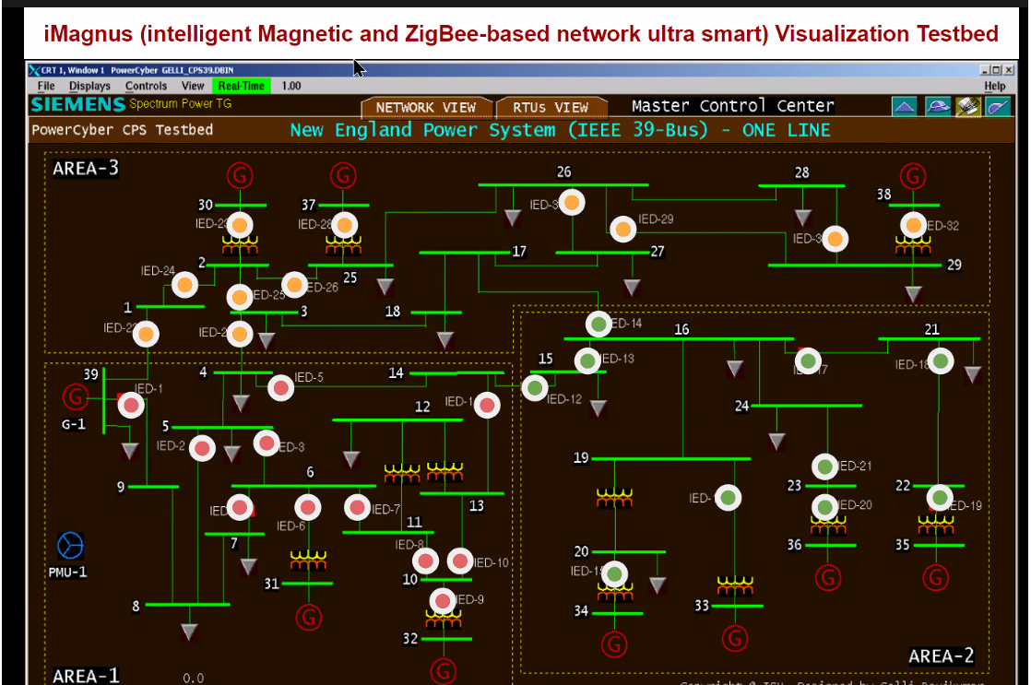
Implementation in action
Using a projector, IOT lights, a coordinator, and a host Laptop with the Smart Light software, the user projects an image of the simulation on a dry erase board, and places the lights at the node points with the assistance of the Smart Light configuration software.
When the simulation is active, users can trigger attacks on different subsections of the grid, and see the interactions with the surrounding nodes.

Slide 6
Requirements Overview
Core Requirements
IOT Light Device shows the state of the simulation at the desired node using an LED.
Able to configure the IOT Smart Lights on Host PC to represent nodes on the simulation.
Light Devices battery powered, with a duration of 8 hours or more.
Light Devices communicate with Hardware Coordinator.
Hardware Coordinator communicates with Host PC.
Host PC communicates with PowerCyber Lab Simulation.
Light Devices are able to trigger an attack on their respective Relay.
Non Functional Requirements
Aesthetically pleasing, Relatively small.
Access to WhiteBoard or magnetic board of some sort.
Light Devices Update to reflect the simulation in <1 second.
Light Devices are Magnetically Mountable.
Light Devices are portable.
Light Devices are scalable to large simulations.
Notes:
Hamza

Slide 7
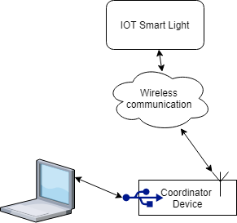
Embedded hardware Requirements on Coordinator
Able to transfer data to and from the Host laptop to the IOT Smart lights.
Able to transfer updates on a relays state to the correct IOT device.
Able to transfer updates on the IOT devices to the Host Laptop if an attack has been generated at the representative relay.
Operable via USB or Serial connection.
Notes:
Will

Slide 8
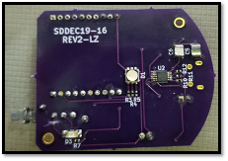
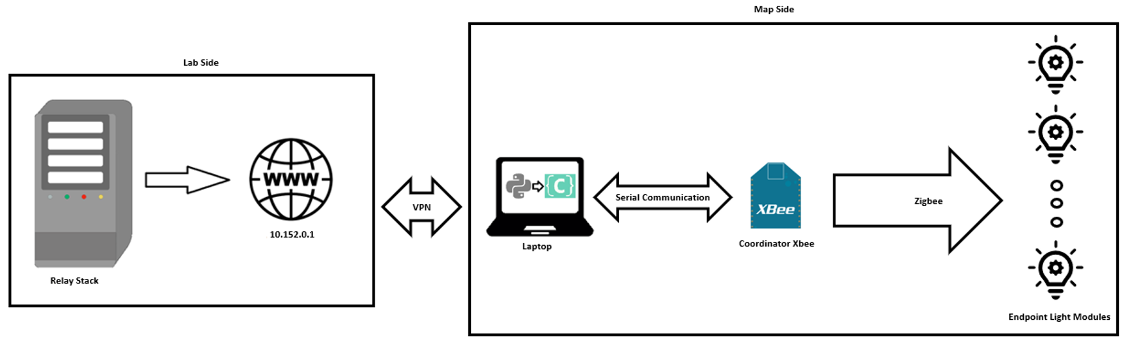
What did the previous team do?
PCB Design:
Designing a board with a XBee chip for controlling one DC light.
Communication:
Reading CSV files from the simulation.
One way communication using Zigbee to the smart lights.
Designed Housing for the PCB:
Battery does not fit.
Notes:
The relay stack is the machine in the lab. Information about the status of the simulation is gathered by a server.
Via a VPN, the client running on a remote computer will pull data from the server and also act as a GUI to control the wireless lights.
An XBee controller physically connects to the laptop running the client application and then controls the wireless lights using ZigBee protocol.

Slide 9
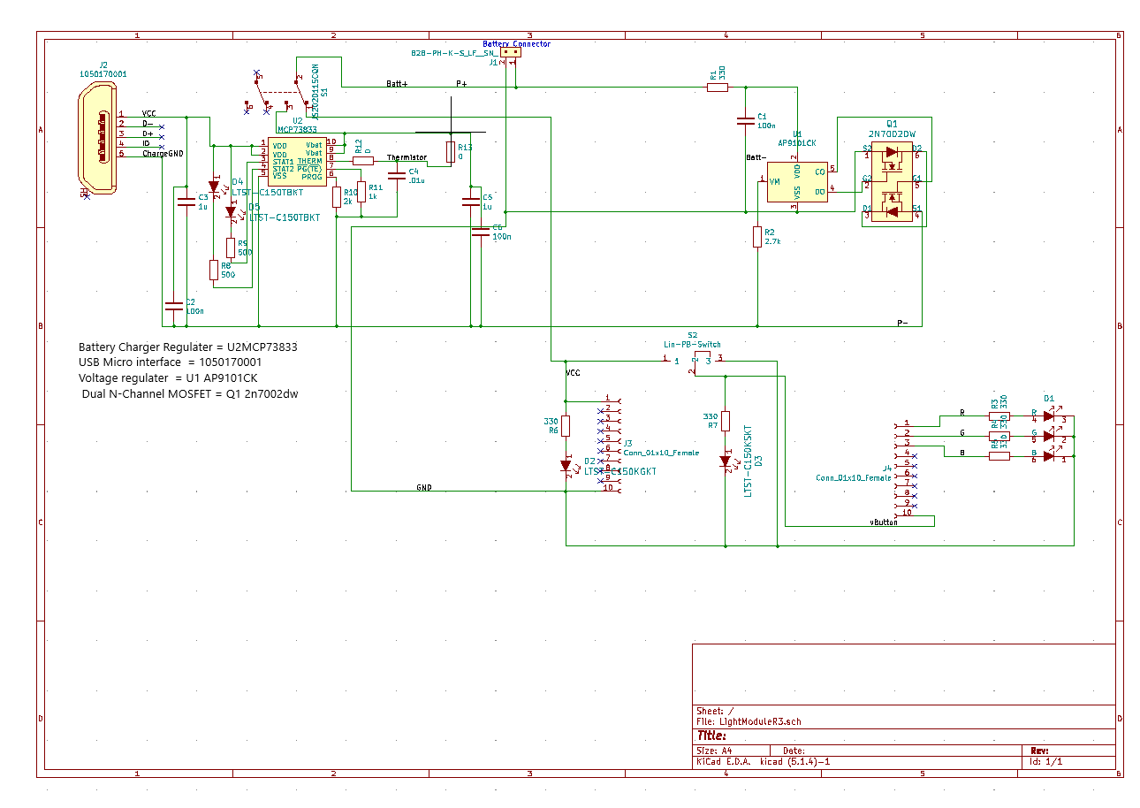
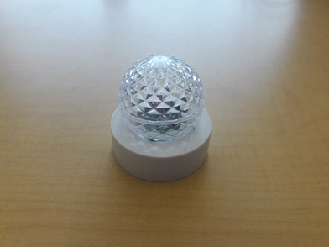
Current State of the hardware
Hardware is capable of the following:
Received updated data on the state of the simulation via zigbee.
Update LED based on received data.
Battery charging off USB interface.
8 hour battery life.
Limitations
One way communication.
Can not be used and charged concurrently.
Not highly scalable.
Drawbacks
Battery does not fit enclosure.
No user input buttons.

Slide 10
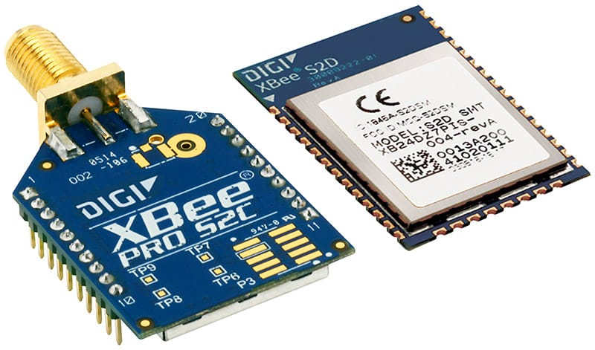
Hardware Prototype Base - Digi Xbee
Hardware readily available.
Supports multiple types of network hierarchy.
Low power transmission.
Can be configured for two way communication. Used as system Router, Endpoint, and Coordinator.
Access to microPython, a C based python implementation.

Slide 11
Proposed improvements to current hardware prototype
2 Way communication between the broadcaster and the IoT light devices.
Addition of hardware buttons.
Additional charging circuitry to allow concurrent usage and charging.

Slide 12
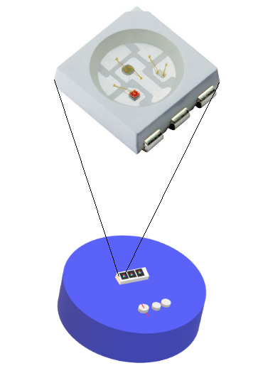
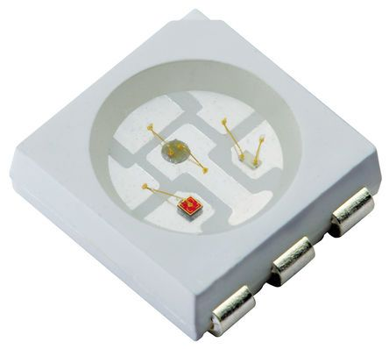
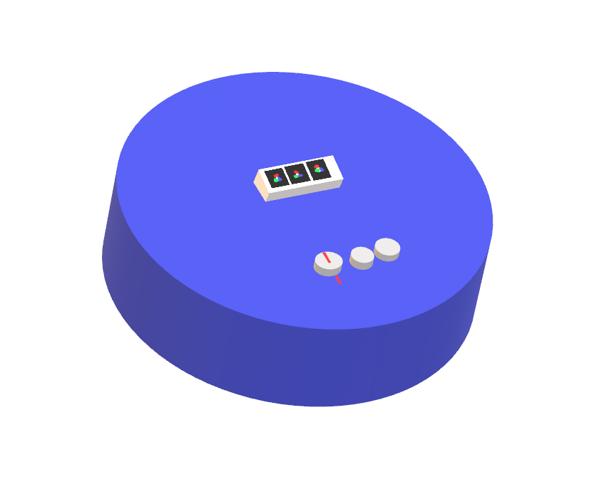
Hardware IOT Light node Breakdown
Using Digi Xbee devices, it’s possible to program in python on the IOT Devices.
This Module will integrate the following components:
Battery
Voltage shifter for 5V to 3.7V
Xbee 2 module used for IO interpretation and wireless communication
Ws2812b RGB Light module or similar module (~50mA/Module), 256^3 possible configurations.
I/O
Dial for selection of the type of attack to simulate
Button to send selected attack
Toggle switch

Slide 13
Power Overhead
Driving power off a 500 mAH battery may pose issues
Rated at 0.2C₅A - 100mA, which can be surpassed when the Smart light is transmitting and driving an LED
Driving multiple LEDs
TX on Xbee s2c poses power requirements that haven’t been considered in this context.
As a prototype comes together it looks like battery usage may be a larger problem that needs to be addressed with a larger capacity.
This can be used as an opportunity to explore wireless charging as well as a larger capacity option.

Slide 14
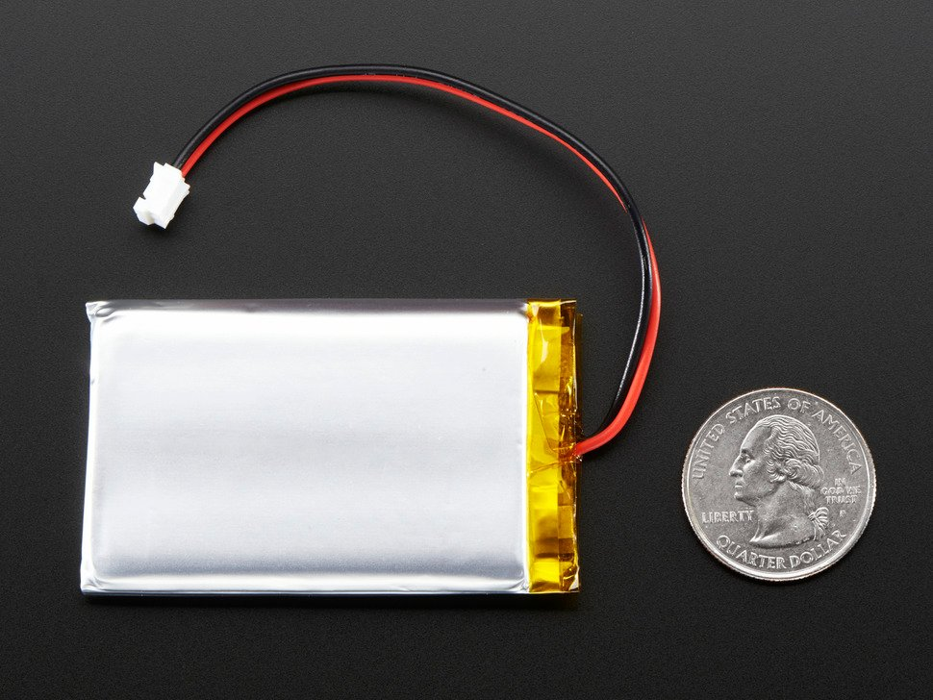
Battery Alternatives
 | Old Battery | New Alternative
Dimensions | 29mm x 36mm x 4.8mm | 60mm x 36mm x 7mm
Capacity | 500 mAh | 2000 mAh
New Battery: Li-Polymer 803860 Battery, shown at right.

Slide 15
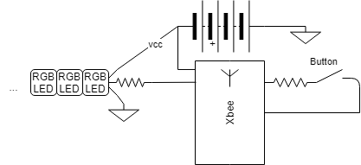
Embedded Hardware Requirements on IOT Lights
Each IOT Light needs to do the following:
2 way communication with Coordinator
Able to respond to >=1 Button inputs
Able to assign RGB colors to the LEDs to reflect power stations on the backend.
Battery that can provide >8 Hours of uptime.
Chargeable using usb Micro
Modular.
Small enough to mount with magnet.

Slide 16
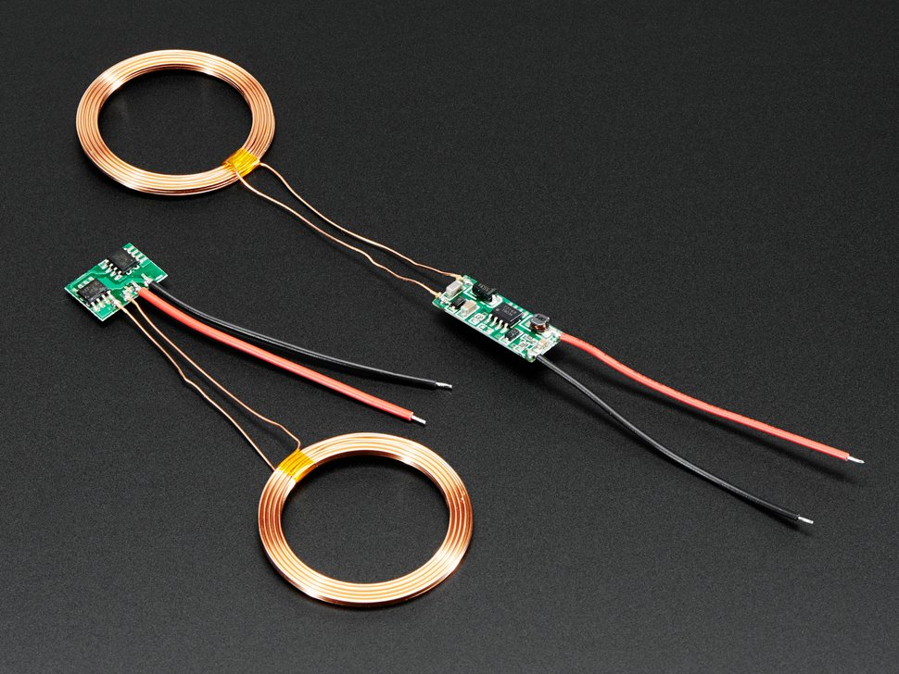
Wireless charging
When the model is scaled up it makes charging all the modules very cumbersome as it requires manually connecting all the modules to many power sources. We can try to avoid this through wireless charging capabilities.
With the addition of a basic inductive charger circuit placed at the base of the smart lights as well as a flat table-like plane to place said lights, simpler charging is possible. Pictured is a candidate module that can help accomplish this additional functionality.
This can attach to the 5V charging input used in place of usb charging.
Source: https://www.adafruit.com/product/1407

Slide 17
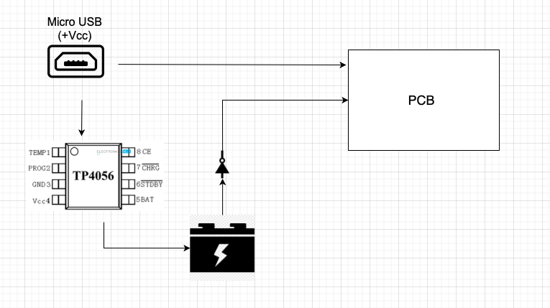
Charging Circuitry addition
One ‘not’ gate used for alternating power source.
TP4056 IC Used to charge Lithium-ion-batteries.
Notes:
Hamza

Slide 18
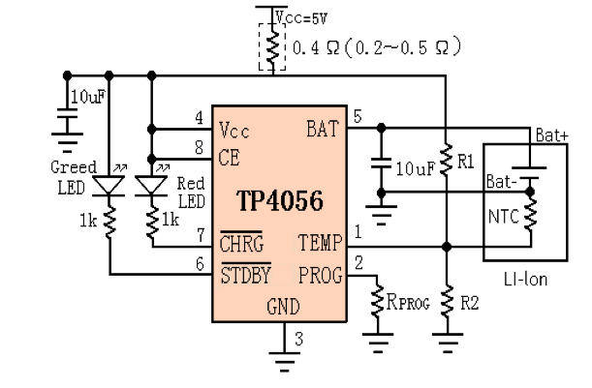
Charging Circuitry Cont.
TP4056 Diagram
Source: https://dlnmh9ip6v2uc.cloudfront.net/datasheets/Prototyping/TP4056.pdf
Notes:
Hamza

Slide 19
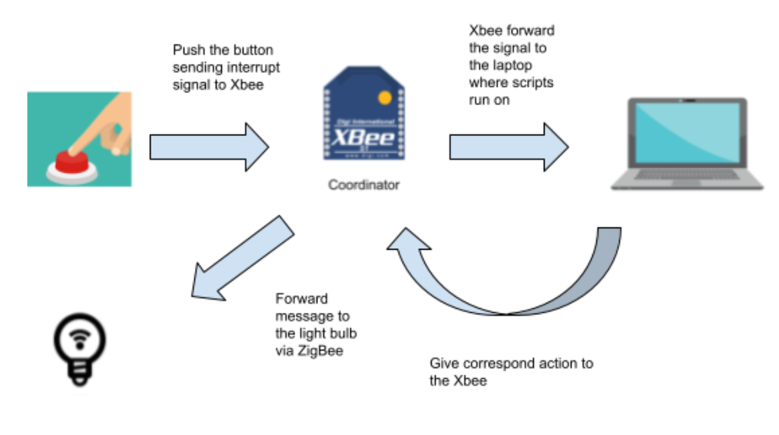
Embedded Smart Light Software Requirements
Wireless IoT lights represent the state of relays in a simulation and are able to trigger attacks on the backend simulation.
Respond to relay state change in a reasonable time (<1 second).
Able to trigger at least one of the types of attacks listed on Section V of Cyber-Physical Security Testbeds after the press of a button.
Use an RGB light to show the status of the powerstation based on the state of the simulation.
Micropython based allowing for use of the neopixel library to control ws2812b RGB LED.
Two way communication with Coordinator.
Notes:
Nathan

Slide 20
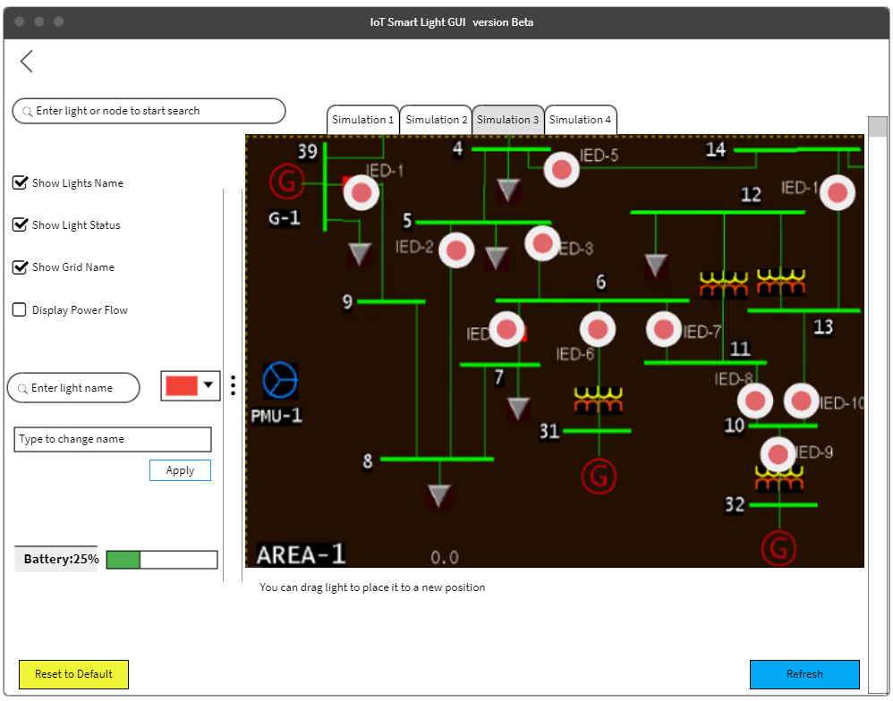
Software Requirements on Host PC
IoT smart light GUI
Shows graphical representation of the power grid simulation.
Users are able to connect to the MySQL database that stores the relay status data.
Users are able to configure light devices (assign physical device a name or number).
Users are able to drag light icon to change the light position.
Users are able to switch the light color by tapping the light icon.
Users are able to switch between different simulation.
Users are able to choose to displace basic information of the simulation.
Notes:
One potential tool is Bubble for building the web based GUI

Slide 21
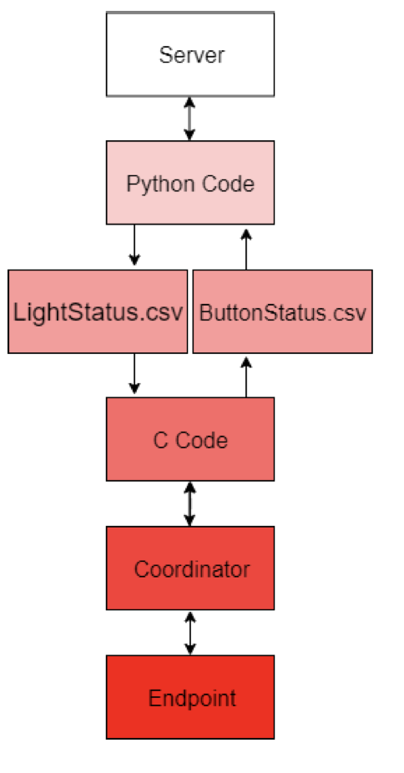
Previous Team software stack
Development:
Language used: Python and C (Reading and writing CSV files).
C code interfaces with XBee coordinator.
C program reads the serial from the coordinator and populates a second CSV file for the Python script to read.
Notes:
Nathan

Slide 22
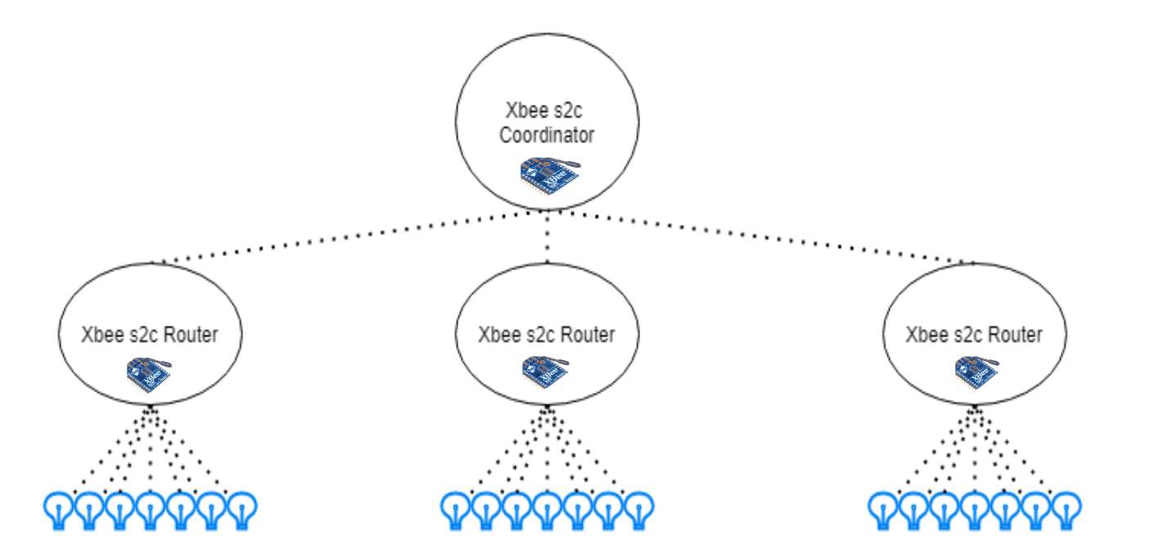
Proposed improvements to current network stack
Adding routers to the mesh communication network
Pros: improve scalability, better reliability and greater wireless coverage.
Cons: sacrifices latency and more devices in the system.
Coordinator would have child nodes that then act as parent nodes to some N number of IOT Smart Lights
Notes:
Xinlei

Slide 23
Current State of Software
The previous team made a test app, written in Python, that took data from a MySQL server storing simulation data to control the lights and show the status of certain objects in a simulation. It does not have a GUI and is not scalable. We would like to build our own application and implement a GUI for improved useability.
Notes:
Nathan

Slide 24
Web-based GUI
Code & Text Editors
Visual Studio Code + google chrome debugger.
Framework
Django or NodeJs.
Driver program interfaces with the hardware coordinator that then writes information from the hardware to a local MySQL server, driven by NodeJS or Python.
This NodeJS server then builds the webmodules to be interlaced within the local html webpage, allowing for configuration and assignment for SmartLight endpoints.

Slide 25
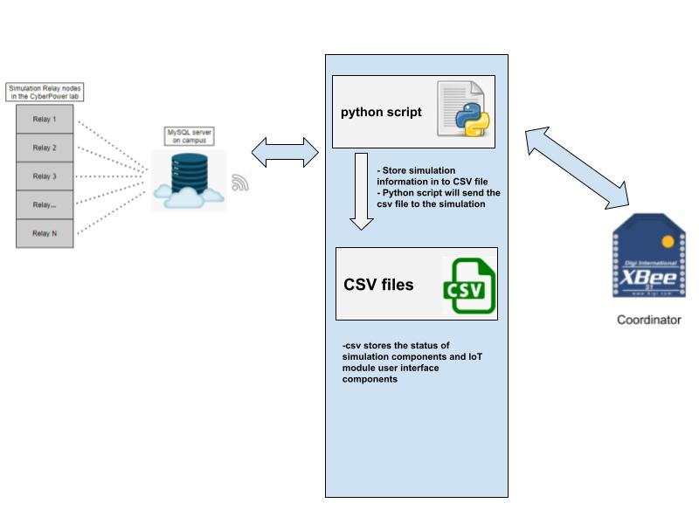
Software Interface and Diagram
Software Interface shows three main interfaces: python script, csv files, and C files.
Using Python to handle the connections the simulation to user interface and Xbee coordinator to the user interface.
Notes:
Unlike the previous team using C program to updates the csv file and connect with the Xbee coordinator(- C file updates the csv file from the simulation.
- C file also responsible connection between the user’s interface and coordinator.)
We will use a single Python to handle the both connections the simulation to user interface and Xbee coordinator to the user interface.

Slide 26
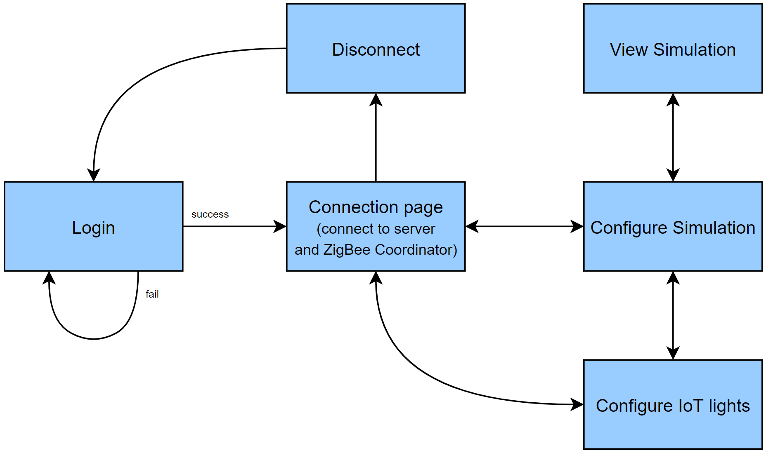
Software flow diagram for host PC application
Notes:
Nathan

Slide 27
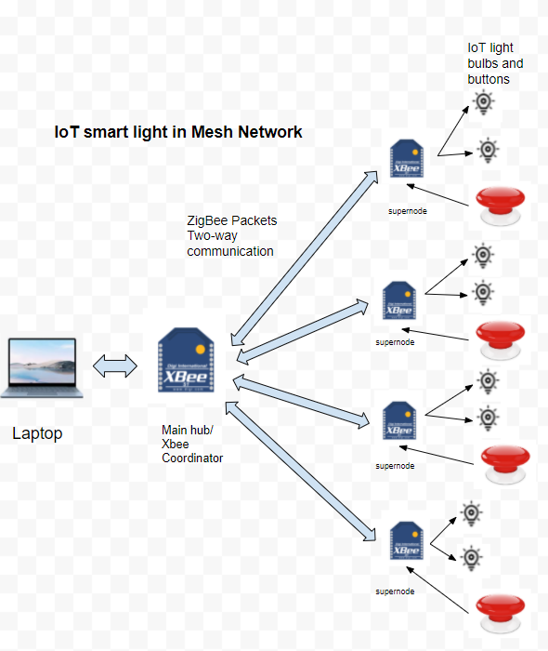
In-depth: ZigBee vs Other IoT protocols
Network Communication Protocols
ZigBee vs LoRa vs Z-Wave
LoRa might capable in longer distance in small data size communication, but it is expensive and not easily implemented in out project
Z-Wave is the most expensive device here and Z-Wave may perform better in smart home not in our IoT project.
Specification
 | ZigBee [1] | LoRa [2] | Z-Wave [3]
Frequency | 915MHz/2.4G | 915MHz | 915MHz (US)
Range | Up to 300+ meters (line of sight) Up to 75-100 meter indoor | 2-5 km (urban) 5-15 km (rural) 15 km (LOS) | 100 meters per hop
Topology | Mesh | Star | Mesh
Power Draw | Low | Low | Low
Data Rate | 250kbps | Between 0.3 kbps to 5.5 kbps | 9.6kbps/40kbps
Notes:
[1] Zigbee source from Zigbee Alliance: https://zigbeealliance.org/solution/zigbee/
[2] LoRa source from LoRa Alliance； https://lora-alliance.org/wp-content/uploads/2020/11/lorawantm_specification_-v1.1.pdf
[3] Z-Wave source from Z-Wave Alliance: https://z-wavealliance.org/what-is-z-wave-long-range-and-how-does-it-differ-from-z-wave/
Supplementary Specification data from https://glowlabs.co/wireless-protocols/
Xinlei
LoRa Range: “Field tests show that LoRa can offer satisfactory network coverage up to 3 km in a suburban area with dense residential dwellings” from https://www.mdpi.com/1424-8220/16/9/1466/htm
Mention Alexa with ZigBee with voice control and

Slide 28
Risks in development and planning
Level of Risk
Spring Semester Result
Counter strategy
1
Team has little experience in PCB development
Moderate
Study and learn as a team
2
Personnel indisposed
Low To High
Other team members can carry on and report any thing critical to the advisors
3
Time is limited to two semesters
Moderate
Stay on track and follow schedule and milestone
Notify team members and advisors
Limits design tasks which can be implemented in one semester.
4
Missing milestone or weekly goal
High
Notify team members and advisors
Team works together to figure out the issue
Potential arrange extra appointments with advisors
Notes:
Team has little experience in PCB development.
Some members have limited experience in IOT, primarily with arduino based applications.
Limited experience in IOT Protocols.
Time is limited to 2 semesters.

Slide 29
Milestones
Finishing design
Finish hardware design, such as the PCB of the light devices.
Complete design of an application with a GUI to configure the IoT light devices.
Concluded embedded software for IoT light devices.
Final Deliverable
Final Deliverable is all functional and will be sent to the client.
Project Kick off
Comprehend previous team’s documents.
Brainstorm idea to upgrade.
Feb 2021
Aug 2021
Jan 2021
Apr 2021
Dec 2021
Settle down and dig deeper
Add due dates for documents and build Gantt chart.
Add tentative timeline and milestone for the second semester.
Finalize part of the project which the team wants to improve.
Implementation and Testing
Implementation Phase kick on.
After implementation, start to test the prototype.
Test on Hardware and Software individually.
Test system interoperability.
Revise the prototype based on the Client feedback.

Slide 30
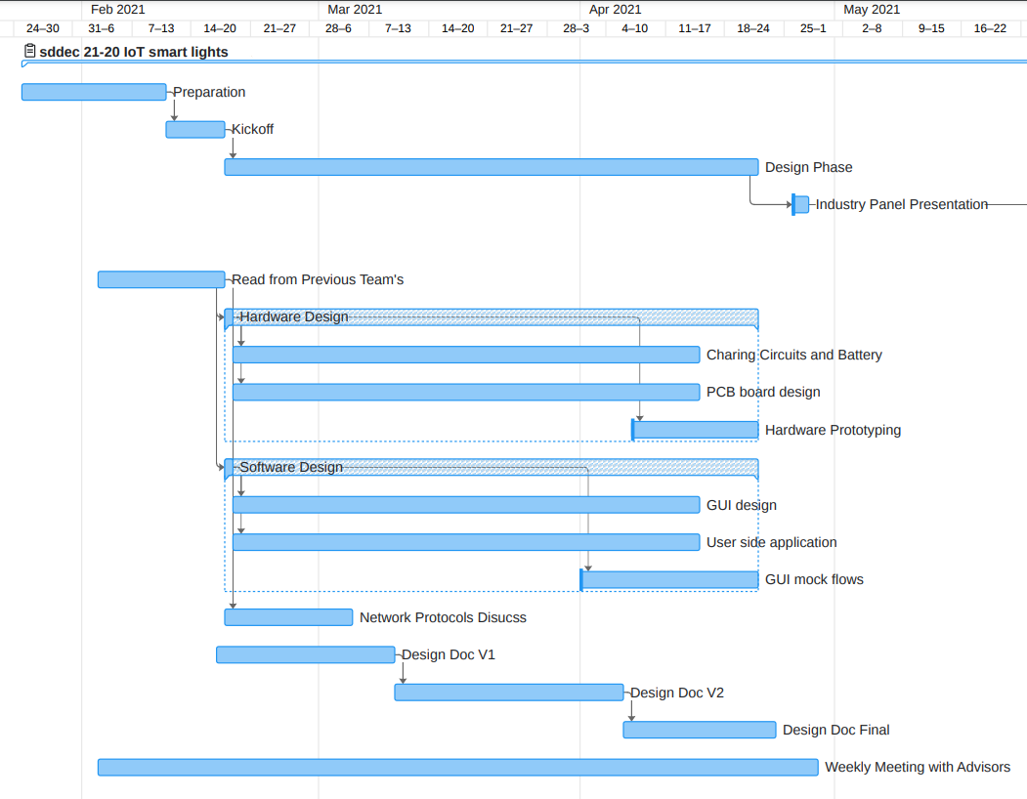
Gantt Chart Spring Semester

Slide 31
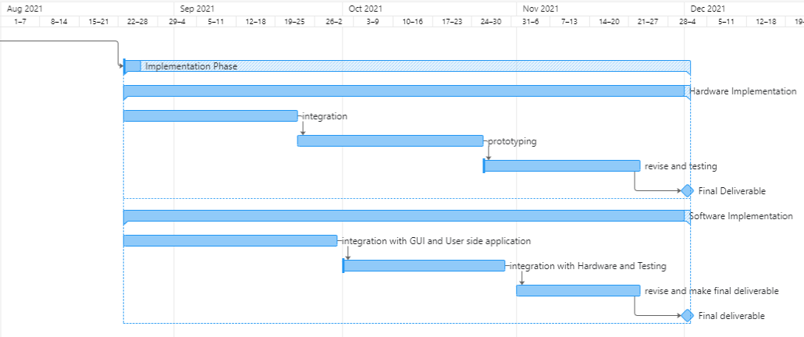
Gantt Chart Fall Semester
Notes:
Xinlei

Slide 32
Q&A

